Slide 1
Pushdown Automata

Slide 2
Pushdown Automata
What is PDA?
Why is the need of PDA?
Model of PDA
Mathematical Definition of PDA
Moves of PDA
ID of PDA
Move relation
Language accepted by PDA
Representation of PDA

Slide 3
What is PDA?
It is an automata or machine which is used to recognize a set of strings.
A PDA is an enhancement of finite automata(FA).
Finite automata with a stack memory can be viewed as Pushdown automata.
PDA = FA + Stack
Addition of stack memory enhances the capability of Pushdown automata as compared to Finite automata.

Slide 4
Why is the need of PDA?
Since Finite automata can accept only regular languages, therefore FA is incapable for accepting context free language, context sensitive language and recursive language.
PDA is designed for accepting context free languages.
Since every regular language is also context free, therefore PDA can accept both type of languages i.e. regular and context free language.

Slide 5
Model of PDA
a | b | c | c | a | b | a | a | a | b
Reading head
Input tape
top
q Finite State Control
B
A
A
B
A
Z0
Stack

Slide 6
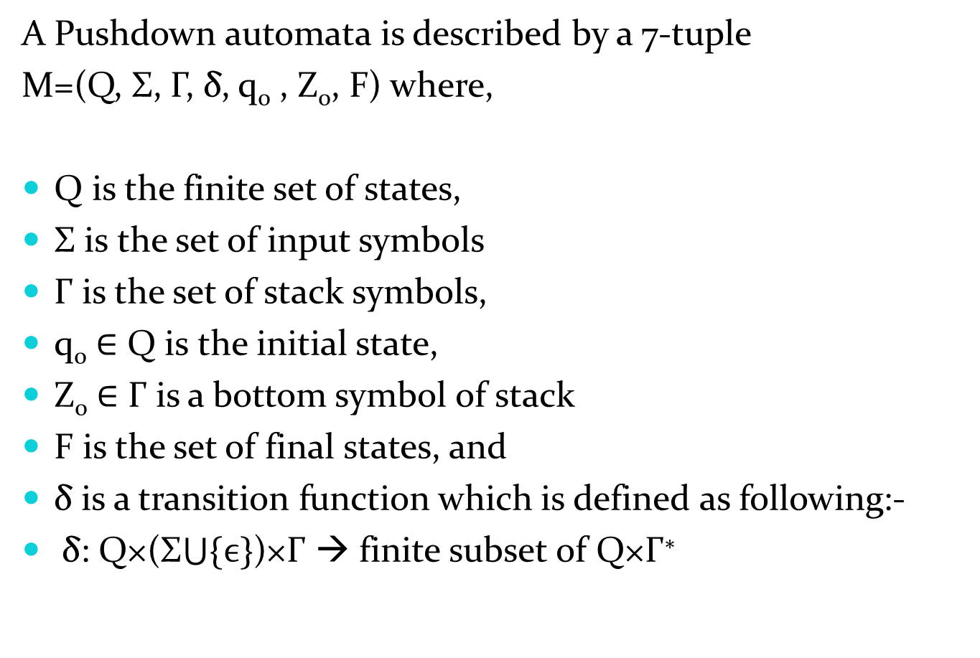
Mathematical Definition of PDA
A Pushdown automata is described by a 7-tuple
M=(Q, Σ, Γ, δ, q₀ , Z₀, F) where,
Q is the finite set of states,
Σ is the set of input symbols
Γ is the set of stack symbols,
q₀ ∈ Q is the initial state,
Z₀ ∈ Γ is a bottom symbol of stack
F is the set of final states, and
δ is a transition function which is defined as following:-
δ: Q×(Σ$\bigcup{\{ϵ\}}$)×Γ → finite subset of Q×Γ∗

Slide 7
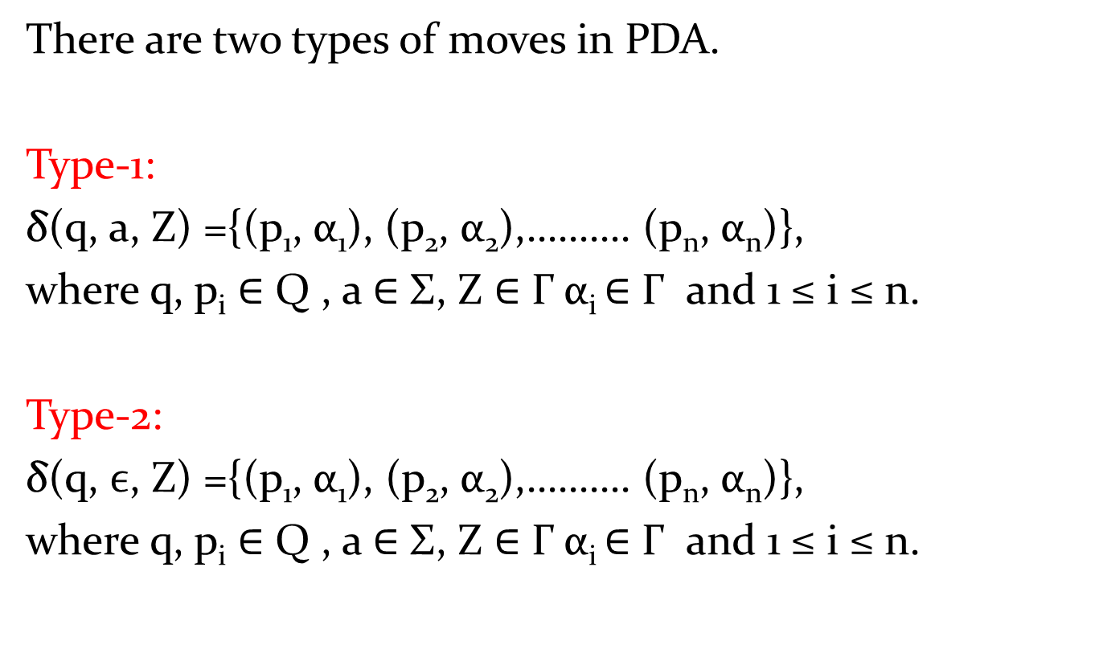
Moves of PDA
There are two types of moves in PDA.
Type-1:
δ(q, a, Z) ={(p₁, α₁), (p₂, α₂),………. (p_{n}, α_{n})},
where q, p_{i} ∈ Q , a ∈ Σ, Z ∈ Γ α_{i} ∈ Γ and 1 ≤ i ≤ n.
Type-2:
δ(q, $ϵ$, Z) ={(p₁, α₁), (p₂, α₂),………. (p_{n}, α_{n})},
where q, p_{i} ∈ Q , a ∈ Σ, Z ∈ Γ α_{i} ∈ Γ and 1 ≤ i ≤ n.

Slide 8
Instantaneous Description(ID)
An instantaneous description of PDA is of the following form:-
(q, x, α)
Where q ∈ Q , x ∈ Σ* and α ∈ Γ* .
Here α represents whole contents with in stack.
And initial ID will be
(q₀, x, Z₀)
q₀ → The initial state
x → The input string which we have taken for processing
Z₀ → Initial contents with in stack.

Slide 9

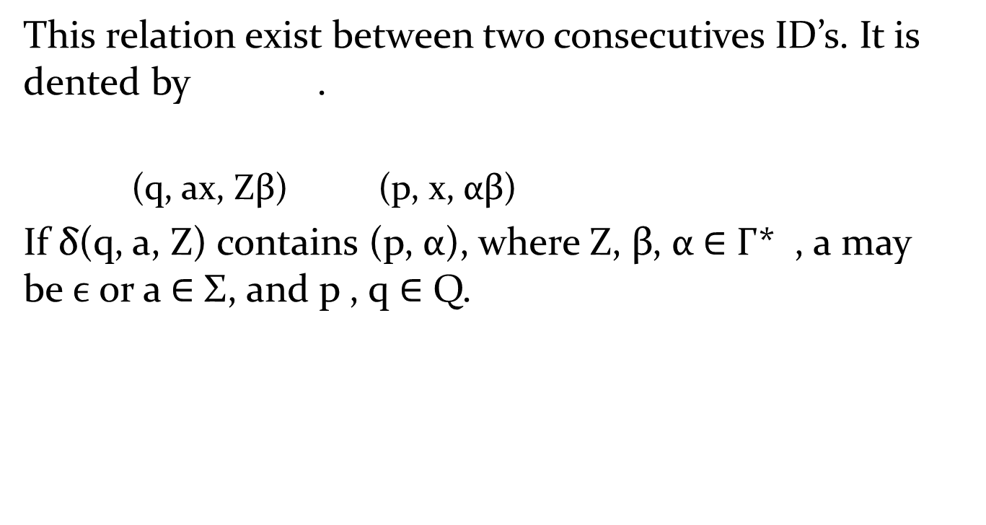
Move relation
This relation exist between two consecutives ID’s. It is dented by .
(q, ax, Zβ) (p, x, αβ)
If δ(q, a, Z) contains (p, α), where Z, β, α ∈ Γ* , a may be$ϵ$ or a ∈ Σ, and p , q ∈ Q.

Slide 10
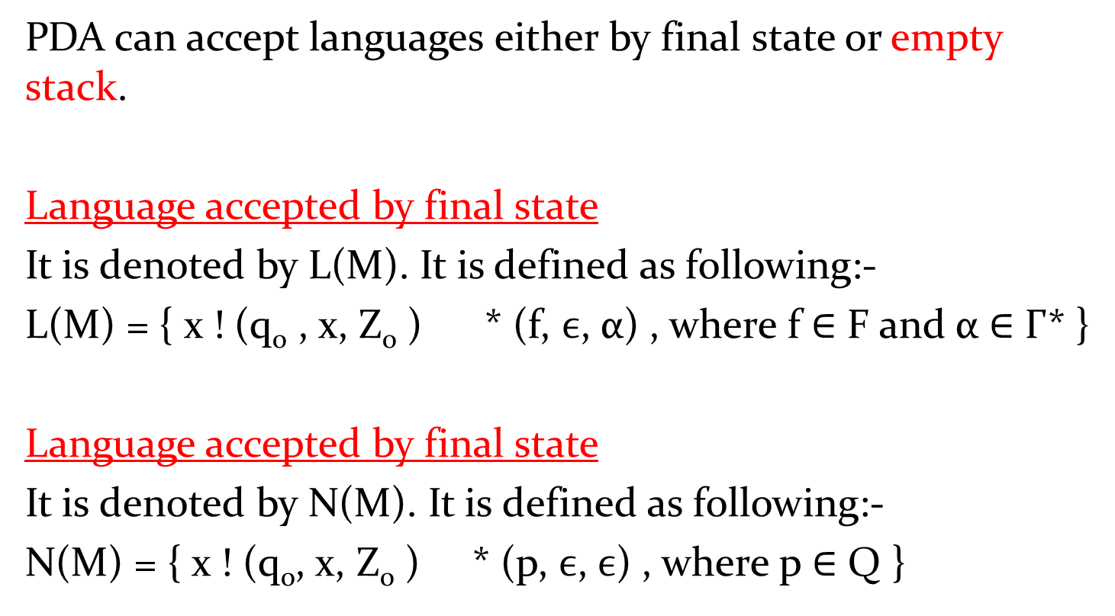
Language accepted by PDA
PDA can accept languages either by final state or empty stack.
Language accepted by final state
It is denoted by L(M). It is defined as following:-
L(M) = { x ! (q₀ , x, Z₀ ) * (f, $ϵ$, α) , where f ∈ F and α ∈ Γ* }
Language accepted by final state
It is denoted by N(M). It is defined as following:-
N(M) = { x ! (q₀, x, Z₀ ) * (p, $ϵ$,$ϵ$) , where p ∈ Q }

Slide 11

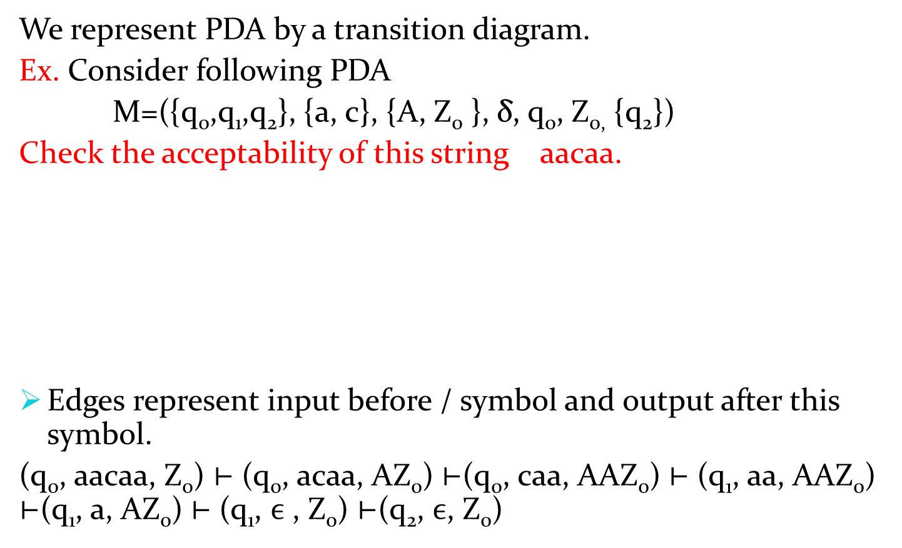

Representation of PDA
We represent PDA by a transition diagram.
Ex. Consider following PDA
M=({q₀,q₁,q₂}, {a, c}, {A, Z₀ }, δ, q₀, Z_{0,} {q₂})
Check the acceptability of this string aacaa.
Edges represent input before / symbol and output after this symbol.
(q₀, aacaa, Z₀) ⊢ (q₀, acaa, AZ₀) ⊢(q₀, caa, AAZ₀) ⊢ (q₁, aa, AAZ₀) ⊢(q₁, a, AZ₀) ⊢ (q₁, $ϵ$ , Z₀) ⊢(q₂, $ϵ$, Z₀)
a, A /AA
a, A /$ϵ$
a, Z₀ /AZ₀
qq0
c, A /A
q1
$ϵ$, Z₀/Z₀
q2

Slide 12
Pushdown Automata
Part-2

Slide 13
Construction of PDA
In this section, we shall see how PDA’s can be constructed.
Ex. Construct PDA to accept the language L={ 0^{n}1^{n} ! n ≥ 1} by final state.
Solution: First we consider a string of a given language and check how it can accept.
Procedure:
In this language, since n numbers of 0’ are followed by n numbers of 1’s, therefore, to check equal number of 0 and 1, we have to push a symbol corresponding to 0 and pop that symbol corresponding to 1. Let that symbol is denoted by A.
Push stack symbol A in to the stack as long as scanned input symbol 0. When next scanned input symbol is 1, find top symbol of stack. If top symbol is A, then pop A from stack. When input pointer reaches at the end of string i.e. input string is empty, find top symbol of stack. If top symbol is Z_{0,} then machine goes to final state. And at this situation, machine accept string.

Slide 14
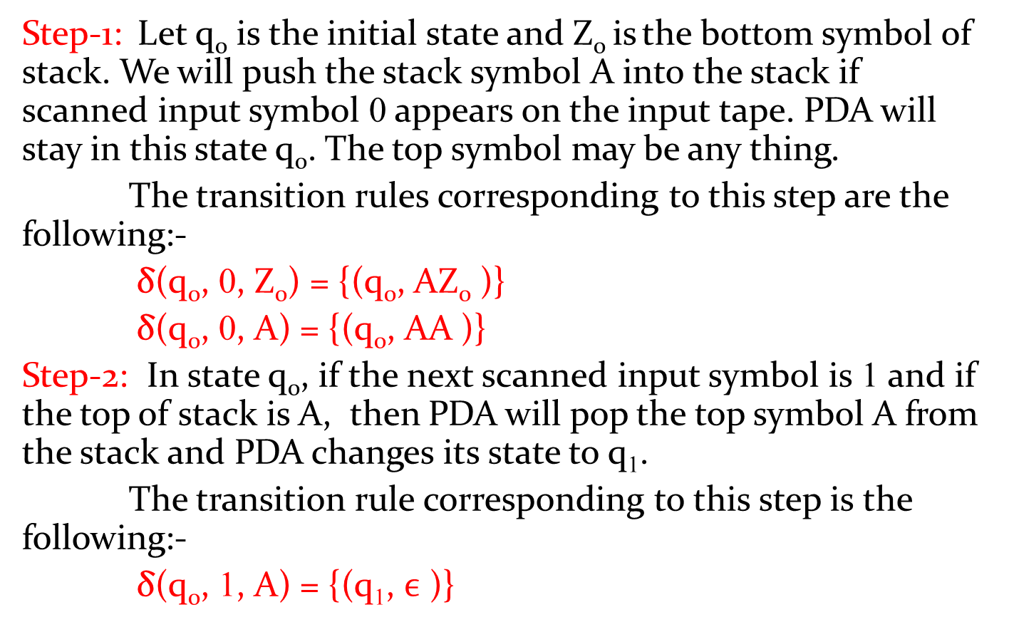
Ex. L={ 0^{n}1^{n} ! n ≥ 1} continue.
Step-1: Let q₀ is the initial state and Z₀ is the bottom symbol of stack. We will push the stack symbol A into the stack if scanned input symbol 0 appears on the input tape. PDA will stay in this state q₀. The top symbol may be any thing.
The transition rules corresponding to this step are the following:-
δ(q₀, 0, Z₀) = {(q₀, AZ₀ )}
δ(q₀, 0, A) = {(q₀, AA )}
Step-2: In state q₀, if the next scanned input symbol is 1 and if the top of stack is A, then PDA will pop the top symbol A from the stack and PDA changes its state to q₁.
The transition rule corresponding to this step is the following:-
δ(q₀, 1, A) = {(q₁, $ϵ$ )}

Slide 15
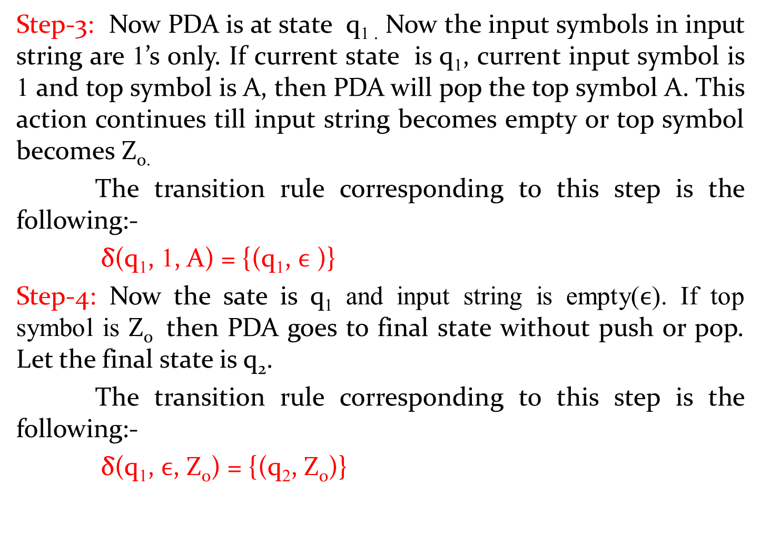
Ex. L={ 0^{n}1^{n} ! n ≥ 1} continue.
Step-3: Now PDA is at state q_{1 .} Now the input symbols in input string are 1’s only. If current state is q₁, current input symbol is 1 and top symbol is A, then PDA will pop the top symbol A. This action continues till input string becomes empty or top symbol becomes Z_{0.}
The transition rule corresponding to this step is the following:-
δ(q₁, 1, A) = {(q₁, $ϵ$ )}
Step-4: Now the sate is q₁ and input string is empty($ϵ$). If top symbol is Z₀ then PDA goes to final state without push or pop. Let the final state is q₂.
The transition rule corresponding to this step is the following:-
δ(q₁, $ϵ$, Z₀) = {(q₂, Z₀)}

Slide 16

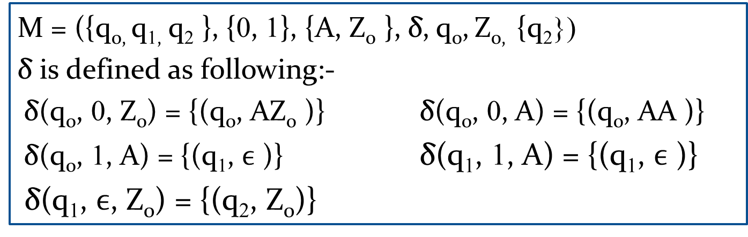


Ex. L={ 0^{n}1^{n} ! n ≥ 1} continue
Therefore final PDA is
M = ({q_{0,} q_{1,} q₂ }, {0, 1}, {A, Z₀ }, δ, q₀, Z_{0,} {q₂})
δ is defined as following:-
δ(q₀, 0, Z₀) = {(q₀, AZ₀ )} δ(q₀, 0, A) = {(q₀, AA )}
δ(q₀, 1, A) = {(q₁, $ϵ$ )} δ(q₁, 1, A) = {(q₁, $ϵ$ )}
δ(q₁, $ϵ$, Z₀) = {(q₂, Z₀)}
0, Z₀/AZ₀
0, A/AA
1, A/$ϵ$
q₀
q₁
q₂
1, A/$ϵ$
$ϵ$, Z₀/Z₀

Slide 17
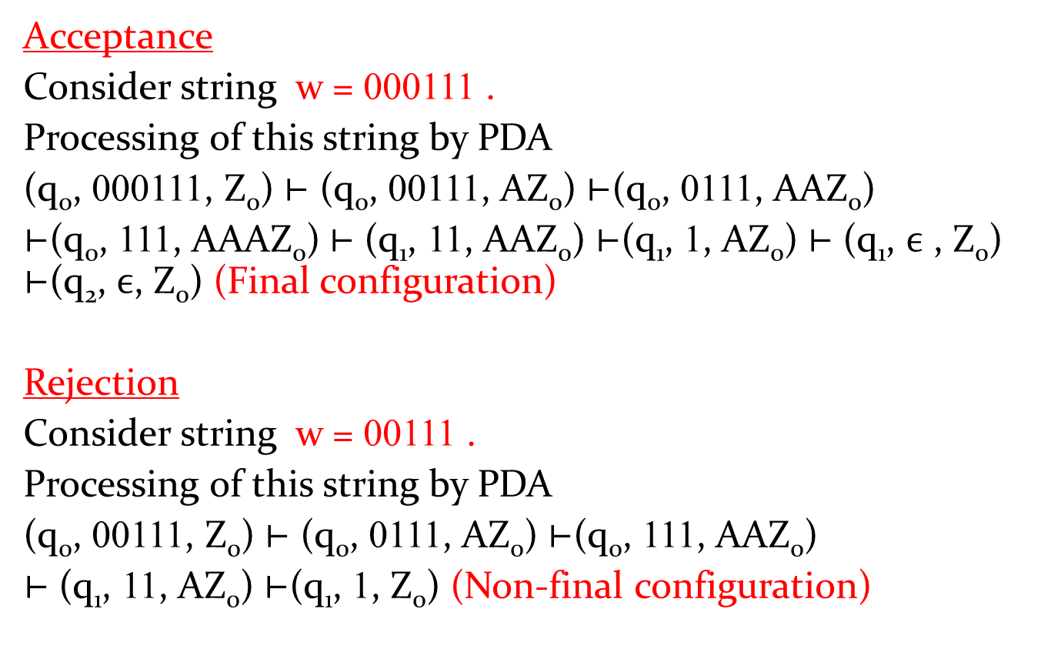
Processing and Verification of above PDA
Acceptance
Consider string w = 000111 .
Processing of this string by PDA
(q₀, 000111, Z₀) ⊢ (q₀, 00111, AZ₀) ⊢(q₀, 0111, AAZ₀)
⊢(q₀, 111, AAAZ₀) ⊢ (q₁, 11, AAZ₀) ⊢(q₁, 1, AZ₀) ⊢ (q₁, $ϵ$ , Z₀) ⊢(q₂, $ϵ$, Z₀) (Final configuration)
Rejection
Consider string w = 00111 .
Processing of this string by PDA
(q₀, 00111, Z₀) ⊢ (q₀, 0111, AZ₀) ⊢(q₀, 111, AAZ₀)
⊢ (q₁, 11, AZ₀) ⊢(q₁, 1, Z₀) (Non-final configuration)

Slide 18
PDA examples continue
Ex. Construct PDA to accept the language
L = { wcw^{R} ! w ∈ {a, b}* } by final state.
Solution:
In this language, w is any string of a and b. w^{R} is the reverse string of w.
If w= abb, then string abbcbba ∈ L. Clearly all the strings belong in to L are palindrome.
Some strings belong in to this set are c, aca, bcb, abcba, bacab etc.
Procedure: In this PDA, we push symbol A and B in to the stack corresponding to input symbol a and b in input string. PDA will stay at the q₀. when c appears in input string, it changes its state to other state(Let it be q₁) without push or pop. At q₁ state, it only pop.
If current input symbol is a and top symbol is A, then pop the top symbol A.
Similarly, If current input symbol is b and top symbol is B, then pop the top symbol B.
At last if input string is empty and top symbol is Z_{0,} then machine goes to final state.

Slide 19
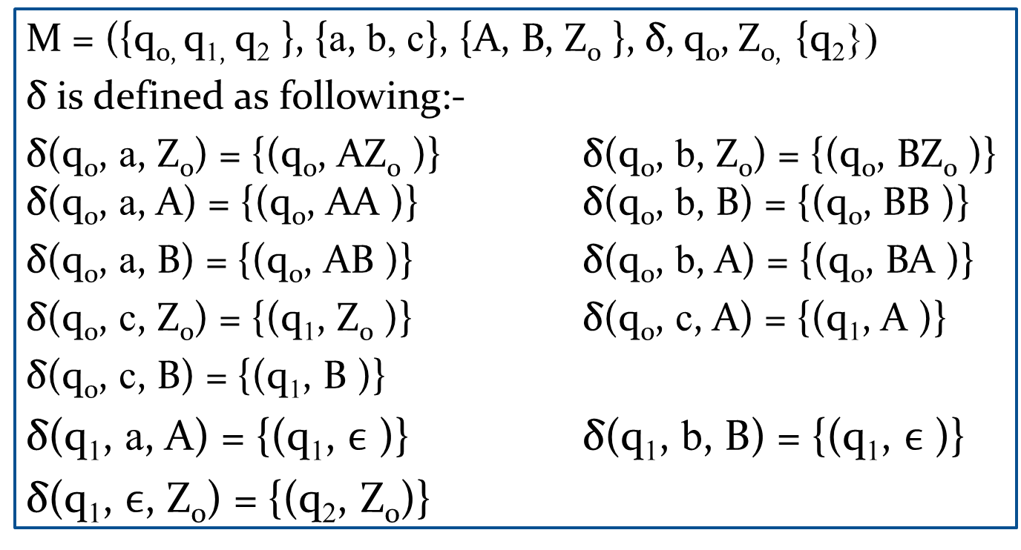
Ex. L={ wcw^{R} ! w ∈ {a, b}* } continue
Therefor e the PDA corresponding to above language is constructed as following:-
M = ({q_{0,} q_{1,} q₂ }, {a, b, c}, {A, B, Z₀ }, δ, q₀, Z_{0,} {q₂})
δ is defined as following:-
δ(q₀, a, Z₀) = {(q₀, AZ₀ )} δ(q₀, b, Z₀) = {(q₀, BZ₀ )} δ(q₀, a, A) = {(q₀, AA )} δ(q₀, b, B) = {(q₀, BB )}
δ(q₀, a, B) = {(q₀, AB )} δ(q₀, b, A) = {(q₀, BA )}
δ(q₀, c, Z₀) = {(q₁, Z₀ )} δ(q₀, c, A) = {(q₁, A )}
δ(q₀, c, B) = {(q₁, B )}
δ(q₁, a, A) = {(q₁, $ϵ$ )} δ(q₁, b, B) = {(q₁, $ϵ$ )}
δ(q₁, $ϵ$, Z₀) = {(q₂, Z₀)}

Slide 20


Ex. L={ wcw^{R} ! w ∈ {a, b}* } continue
Transition diagram of PDA is the following:-
a, A/$ϵ$
b, B/$ϵ$
a, Z₀/AZ₀
a, A/AA
a, B/AB
b, Z₀/BZ₀
b, A/BA
b, B/BB
q₀
q₁
q₂
c, Z₀/Z₀
c, A/A
c, B/B
$ϵ$, Z₀/Z₀

Slide 21
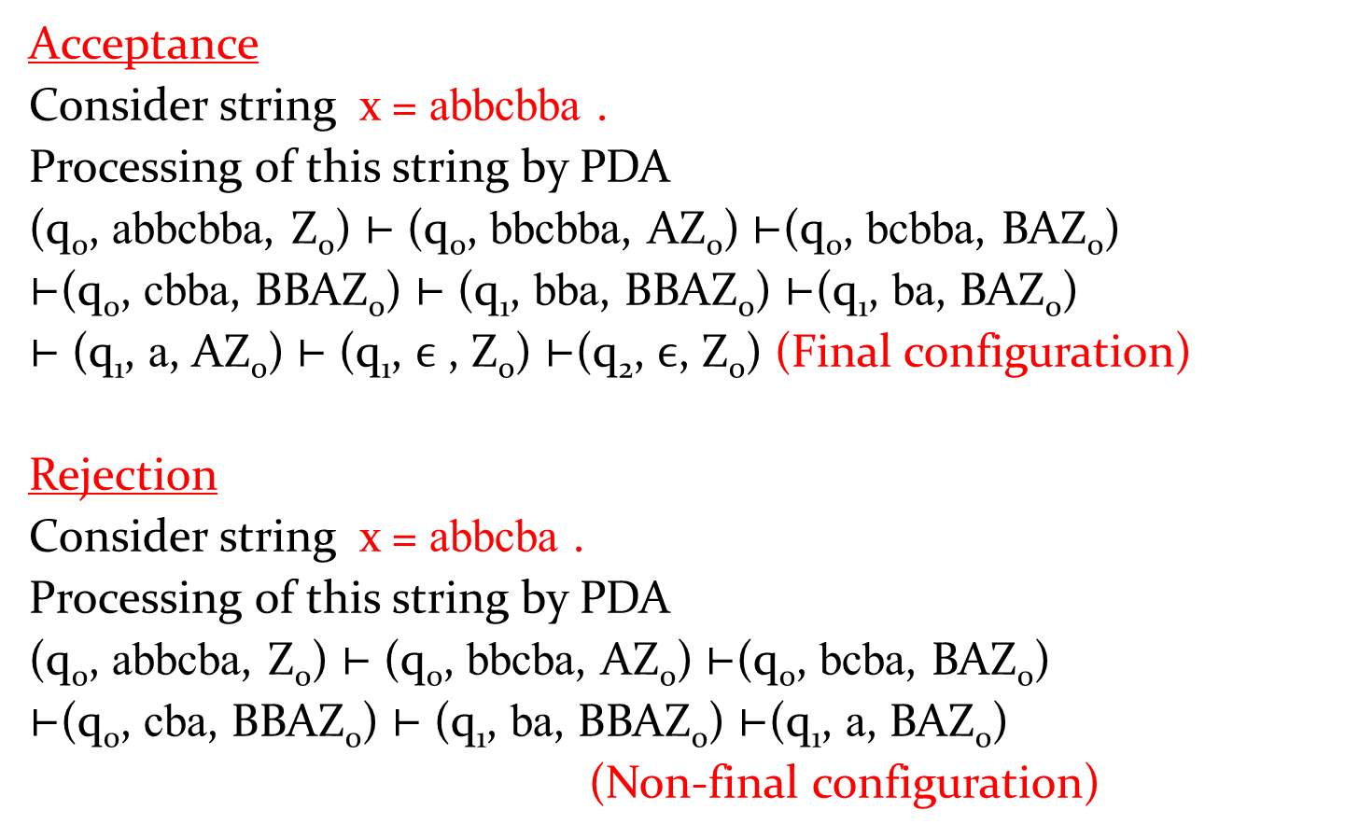
Processing and Verification of above PDA
Acceptance
Consider string x = abbcbba .
Processing of this string by PDA
(q₀, abbcbba, Z₀) ⊢ (q₀, bbcbba, AZ₀) ⊢(q₀, bcbba, BAZ₀)
⊢(q₀, cbba, BBAZ₀) ⊢ (q₁, bba, BBAZ₀) ⊢(q₁, ba, BAZ₀)
⊢ (q₁, a, AZ₀) ⊢ (q₁, $ϵ$ , Z₀) ⊢(q₂, $ϵ$, Z₀) (Final configuration)
Rejection
Consider string x = abbcba .
Processing of this string by PDA
(q₀, abbcba, Z₀) ⊢ (q₀, bbcba, AZ₀) ⊢(q₀, bcba, BAZ₀)
⊢(q₀, cba, BBAZ₀) ⊢ (q₁, ba, BBAZ₀) ⊢(q₁, a, BAZ₀)
(Non-final configuration)

Slide 22
Pushdown Automata
Part-3

Slide 23
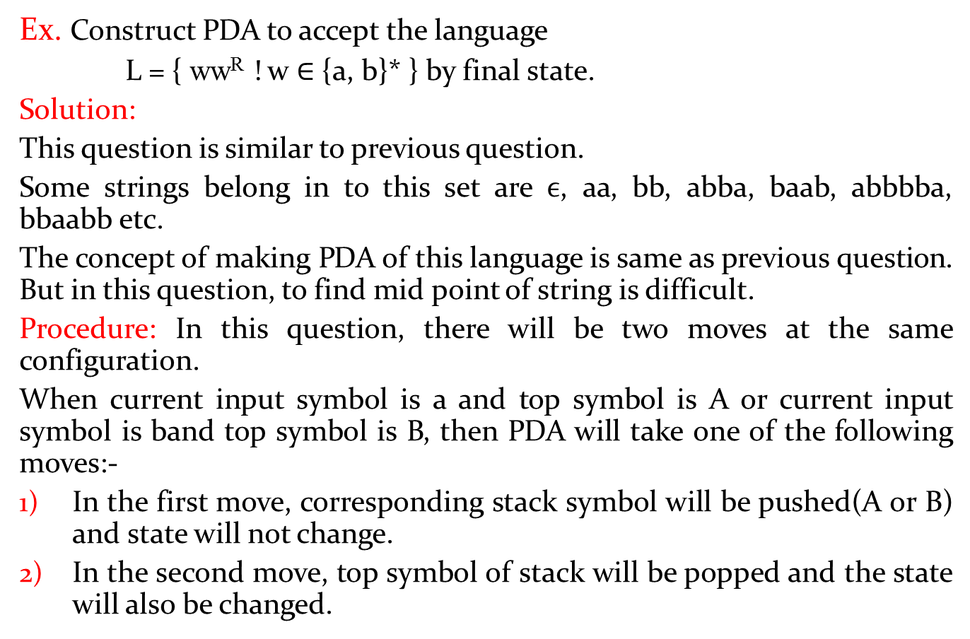
PDA examples continue
Ex. Construct PDA to accept the language
L = { ww^{R} ! w ∈ {a, b}* } by final state.
Solution:
This question is similar to previous question.
Some strings belong in to this set are $ϵ$, aa, bb, abba, baab, abbbba, bbaabb etc.
The concept of making PDA of this language is same as previous question. But in this question, to find mid point of string is difficult.
Procedure: In this question, there will be two moves at the same configuration.
When current input symbol is a and top symbol is A or current input symbol is band top symbol is B, then PDA will take one of the following moves:-
In the first move, corresponding stack symbol will be pushed(A or B) and state will not change.
In the second move, top symbol of stack will be popped and the state will also be changed.

Slide 24

Ex. L={ ww^{R} ! w ∈ {a, b}* } continue
Therefor e the PDA corresponding to above language is constructed as following:-
M = ({q_{0,} q_{1,} q₂ }, {a, b}, {A, B, Z₀ }, δ, q₀, Z_{0,} {q₂})
δ is defined as following:-
δ(q₀, a, Z₀) = {(q₀, AZ₀ )} δ(q₀, b, Z₀) = {(q₀, BZ₀ )} δ(q₀, a, A) = {(q₀, AA ), (q₁, $ϵ$ )} δ(q₀, a, B) = {(q₀, AB )}
δ(q₀, b, B) = {(q₀, BB ), (q₁, $ϵ$)} δ(q₀, b, A) = {(q₀, BA )}
δ(q₀, $ϵ$, Z₀) = {(q₁, Z₀ )} δ(q₁, a, A) = {(q₁, $ϵ$ )} δ(q₁, b, B) = {(q₁, $ϵ$ )} δ(q₁, $ϵ$, Z₀) = {(q₂, Z₀)}

Slide 25
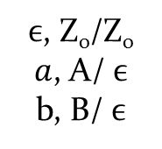
Ex. L={ ww^{R} ! w ∈ {a, b}* } continue
Transition diagram of PDA is the following:-
a, A/$ϵ$
b, B/$ϵ$
a, Z₀/AZ₀
a, A/AA
a, B/AB
b, Z₀/BZ₀
b, A/BA
b, B/BB
q₀
q₁
q₂
$ϵ$, Z₀/Z₀
$a$, A/ $ϵ$
b, B/ $ϵ$
$ϵ$, Z₀/Z₀

Slide 26
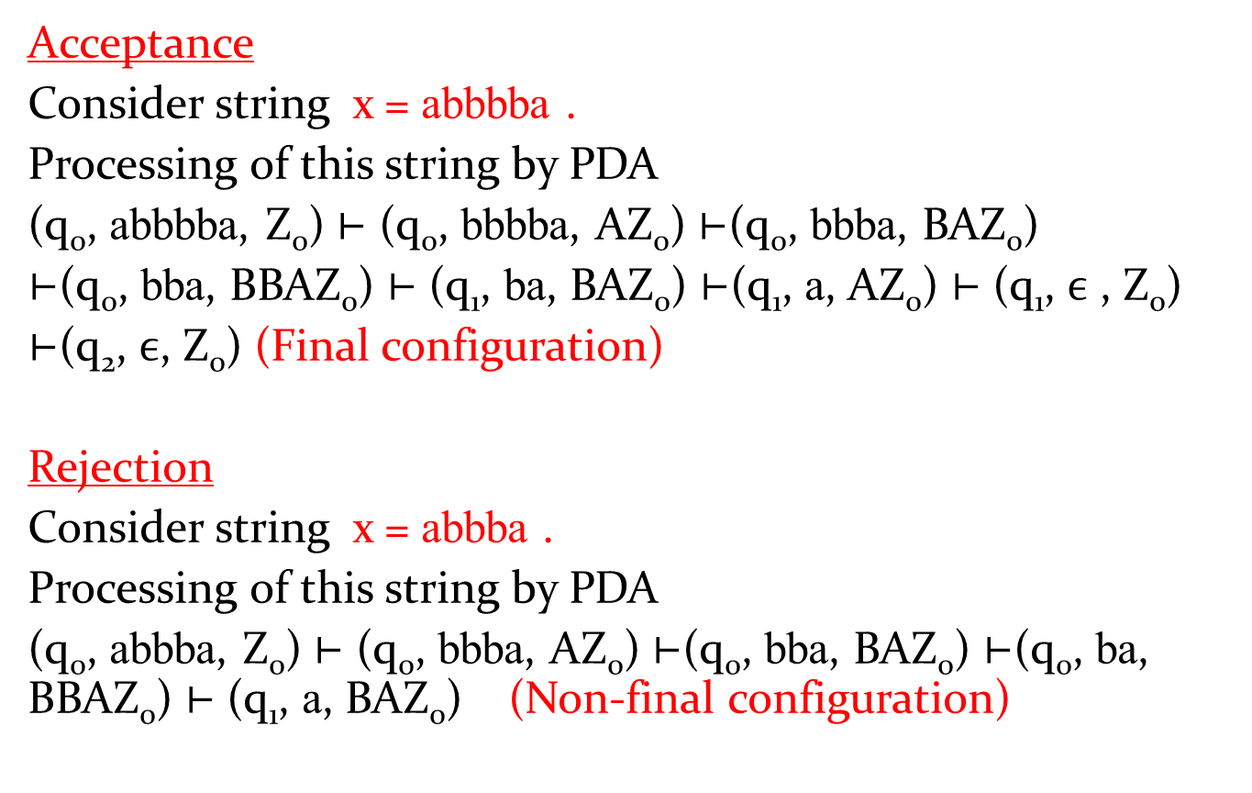
Processing and Verification of above PDA
Acceptance
Consider string x = abbbba .
Processing of this string by PDA
(q₀, abbbba, Z₀) ⊢ (q₀, bbbba, AZ₀) ⊢(q₀, bbba, BAZ₀)
⊢(q₀, bba, BBAZ₀) ⊢ (q₁, ba, BAZ₀) ⊢(q₁, a, AZ₀) ⊢ (q₁, $ϵ$ , Z₀)
⊢(q₂, $ϵ$, Z₀) (Final configuration)
Rejection
Consider string x = abbba .
Processing of this string by PDA
(q₀, abbba, Z₀) ⊢ (q₀, bbba, AZ₀) ⊢(q₀, bba, BAZ₀) ⊢(q₀, ba, BBAZ₀) ⊢ (q₁, a, BAZ₀) (Non-final configuration)

Slide 27
Some questions
Construct PDA to accept the following languages:-
L = { a^{n} b^{2n} ! n ≥ 1 }
L = { a^{n} b^{3n} ! n ≥ 1 }
L = { a^{m} b^{n} c^{n} d^{m} ! m, n ≥ 1 }
L = { a^{n} b^{m} c^{n} ! m, n ≥ 1 }
L = {a^{i} b^{j} c^{k} ! i = j or j = k}

Slide 28
Ex. Construct PDA to accept the language
L = { a^{n} b^{2n} ! n ≥ 1 } by empty stack.
Solution:
In this question, number of b is two times of number of a. Therefore, the PDA should read two b corresponding to one a.
In this question, when a appears in input string, then push the stack symbol A in to the stack.
When b appears in input string, then machine change its state. When second b appears input string, then we change sate and pop the top symbol of stack.
In this question, PDA will pop a top symbol from stack when bb(i.e two b) appears in the input string.

Slide 29

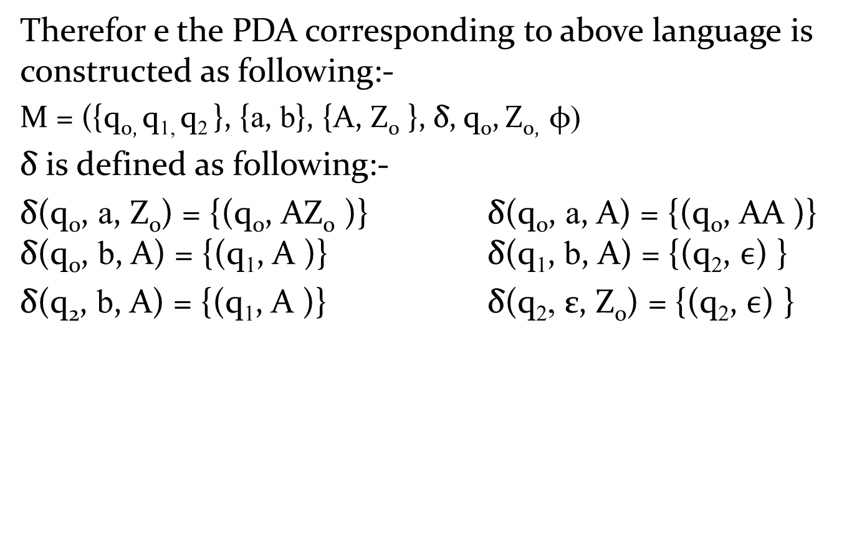



L = { a^{n} b^{2n} ! n ≥ 1 }
Therefor e the PDA corresponding to above language is constructed as following:-
M = ({q_{0,} q_{1,} q₂ }, {a, b}, {A, Z₀ }, δ, q₀, Z_{0,} φ)
δ is defined as following:-
δ(q₀, a, Z₀) = {(q₀, AZ₀ )} δ(q₀, a, A) = {(q₀, AA )} δ(q₀, b, A) = {(q₁, A )} δ(q₁, b, A) = {(q₂, $ϵ$) }
δ(q₂, b, A) = {(q₁, A )} δ(q₂, ε, Z₀) = {(q₂, $ϵ$) }
$ϵ$, Z₀ /$ϵ$
a, Z₀/AZ₀
a, A/AA
b, A/$A$
q₀
q₁
q₂
b, A/$A$
$b$, A/$ϵ$

Slide 30
Ex. Construct PDA to accept the language
L = { a^{m} b^{n} c^{n} d^{m} ! m, n ≥ 1 } by empty stack.
Soultion:
Some strings belong in to this set are abcd, abbccd, aabcdd, aaabbccddd etc.
In this language, number of a and d are equal and number of b and c are equal.
Therefore, we have to push stack symbol corresponding to a and pop that stack symbol corresponding to d.
Similarly, we have to push another stack symbol corresponding to b and pop that stack symbol corresponding to c.
To preserve the order of a, b, c and d, machine changes its state when move from a to b, b to c, and c to d.

Slide 31

Therefor e the PDA corresponding to above language is constructed as following:-
M = ({q_{0,} q_{1,} q_{2,} q₃ }, {a, b, c, d}, {A, B, Z₀ }, δ, q₀, Z_{0,} φ )
δ is defined as following:-
δ(q₀, a, Z₀) = {(q₀, AZ₀ )} δ(q₀, a, A) = {(q₀, AA )} δ(q₀, b, A) = {(q₁, BA )} δ(q₁, b, B) = {(q₁, BB ) }
δ(q₁, c, B) = {(q₂, $ϵ$ )} δ(q₂, c, B) = {(q₂, $ϵ$ )}
δ(q₂, d, A) = {(q₃, $ϵ$ )} δ(q₃, d, A) = {(q₃, $ϵ$ )}
δ(q₃, $ϵ$, Z₀) = {(q₃, $ϵ$ )}

Slide 32

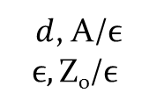




L = { a^{m}b^{n} c^{n}d^{m} ! m, n ≥ 1 }
Transition diagram of PDA is the following:-
b, B/$BB$
a, Z₀/AZ₀
a, A/AA
$c$, B/$ϵ$
$d$, A/$ϵ$
$$ϵ,\text{Z}\text{0}\text{/}ϵ$$
q₀
q₁
q₂
q₃
$b$, A/BA
$c$, B/$ϵ$
$d$, A/$ϵ$

Slide 33
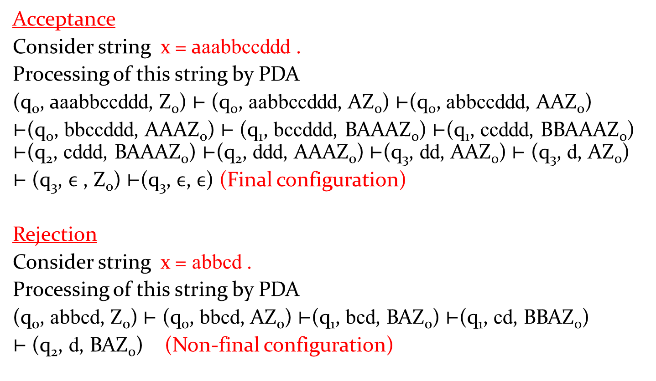
Processing and Verification of above PDA
Acceptance
Consider string x = aaabbccddd .
Processing of this string by PDA
(q₀, aaabbccddd, Z₀) ⊢ (q₀, aabbccddd, AZ₀) ⊢(q₀, abbccddd, AAZ₀)
⊢(q₀, bbccddd, AAAZ₀) ⊢ (q₁, bccddd, BAAAZ₀) ⊢(q₁, ccddd, BBAAAZ₀) ⊢(q₂, cddd, BAAAZ₀) ⊢(q₂, ddd, AAAZ₀) ⊢(q₃, dd, AAZ₀) ⊢ (q₃, d, AZ₀)
⊢ (q₃, $ϵ$ , Z₀) ⊢(q₃, $ϵ$, $ϵ$) (Final configuration)
Rejection
Consider string x = abbcd .
Processing of this string by PDA
(q₀, abbcd, Z₀) ⊢ (q₀, bbcd, AZ₀) ⊢(q₁, bcd, BAZ₀) ⊢(q₁, cd, BBAZ₀)
⊢ (q₂, d, BAZ₀) (Non-final configuration)

Slide 34




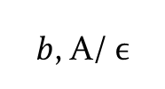






Ex. L = {a^{i} b^{j} c^{k} ! i = j or j = k}
The PDA corresponding to this language is the following:-
$ϵ$, Z₀/$\text{Z}\text{0}$
b, A/$ϵ$
a, Z₀/AZ₀
a, A/AA
a, Z₀/Z₀
$c$, Z₀/$\text{Z}\text{0}$
q₀
$b$, A/ $ϵ$
q₁
$c$, Z₀/$\text{Z}\text{0}$
q₂
$ϵ$, Z₀/$\text{Z}\text{0}$
q₃
$b$, B/$BB$
$c$, B/$ϵ$
$b$, Z₀/B$\text{Z}\text{0}$
q₄
q₅
$ϵ$, Z₀/$\text{Z}\text{0}$
$c$, B/$ϵ$

Slide 35
PDA examples continue
Construct PDA to accept the following languages:-
L = { w ! w ∈ {a,b}* and n_{a}(w) = n_{b}(w) }
L = { w ! w ∈ {a,b}* and n_{a}(w) ≥ n_{b}(w) }
L = { w ! w ∈ {a,b}* and n_{a}(w) ≠ n_{b}(w) }

Slide 36
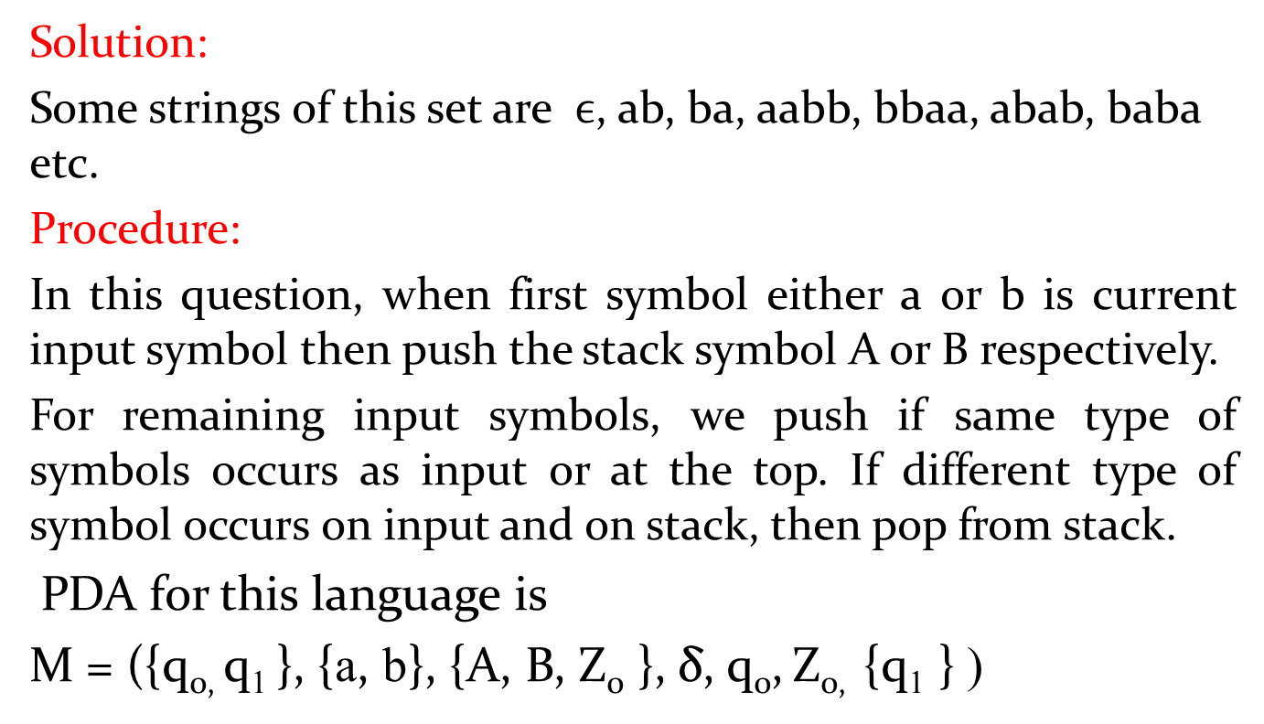
Ex. L = { w ! w ∈ {a,b}* and n_{a}(w) = n_{b}(w) }
Solution:
Some strings of this set are $ϵ$, ab, ba, aabb, bbaa, abab, baba etc.
Procedure:
In this question, when first symbol either a or b is current input symbol then push the stack symbol A or B respectively.
For remaining input symbols, we push if same type of symbols occurs as input or at the top. If different type of symbol occurs on input and on stack, then pop from stack.
PDA for this language is
M = ({q_{0,} q₁ }, {a, b}, {A, B, Z₀ }, δ, q₀, Z_{0,} {q₁ } )

Slide 37



PDA examples continue
δ is defined as following:-
δ(q₀, a, Z₀) = {(q₀, AZ₀ )} δ(q₀, b, Z₀) = {(q₀, BZ₀ )}
δ(q₀, a, A) = {(q₀, AA )} δ(q₀, b, B) = {(q₁, BB )}
δ(q₀, a, B) = {(q₀, $ϵ$ )} δ(q₀, b, A) = {(q₂, $ϵ$ )}
δ(q₀, $ϵ$, Z₀) = {(q₁, Z₀ )}
Transition diagram of PDA for above language is
a, A/AA
b, B/BB
a, B/ $ϵ$
b, A/ $ϵ$
a, Z₀/AZ₀
b, Z₀/BZ₀
q₀
q₁
$ϵ ,$Z₀/Z₀

Slide 38
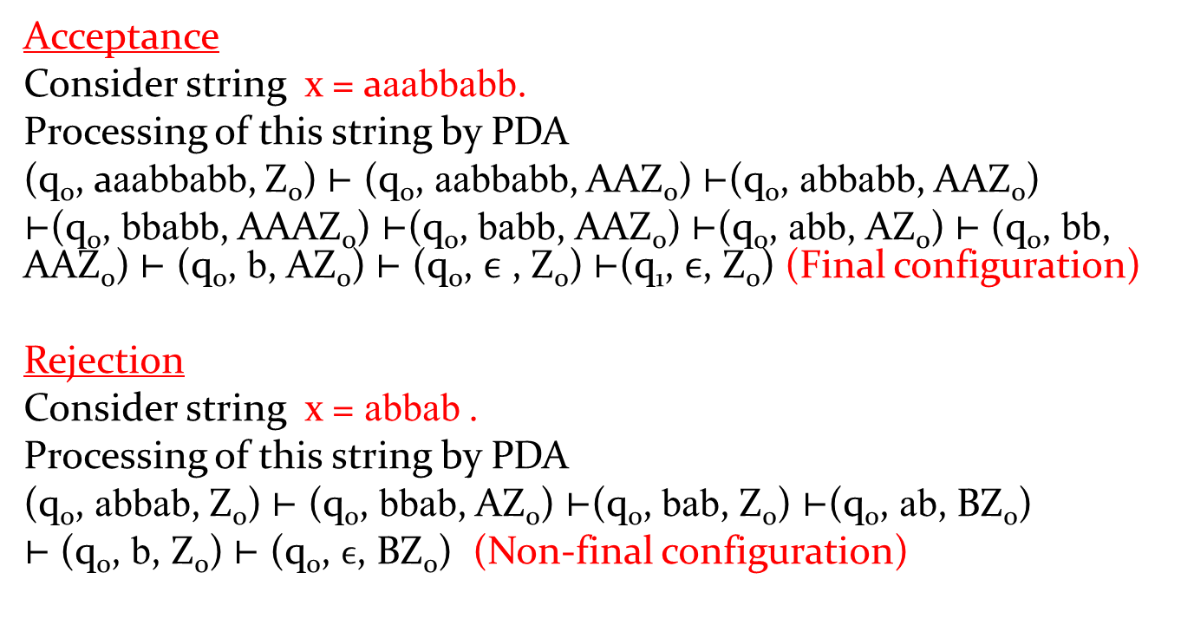
Processing and Verification of above PDA
Acceptance
Consider string x = aaabbabb.
Processing of this string by PDA
(q₀, aaabbabb, Z₀) ⊢ (q₀, aabbabb, AAZ₀) ⊢(q₀, abbabb, AAZ₀)
⊢(q₀, bbabb, AAAZ₀) ⊢(q₀, babb, AAZ₀) ⊢(q₀, abb, AZ₀) ⊢ (q₀, bb, AAZ₀) ⊢ (q₀, b, AZ₀) ⊢ (q₀, $ϵ$ , Z₀) ⊢(q₁, $ϵ$, Z₀) (Final configuration)
Rejection
Consider string x = abbab .
Processing of this string by PDA
(q₀, abbab, Z₀) ⊢ (q₀, bbab, AZ₀) ⊢(q₀, bab, Z₀) ⊢(q₀, ab, BZ₀)
⊢ (q₀, b, Z₀) ⊢ (q₀, $ϵ$, BZ₀) (Non-final configuration)

Slide 39
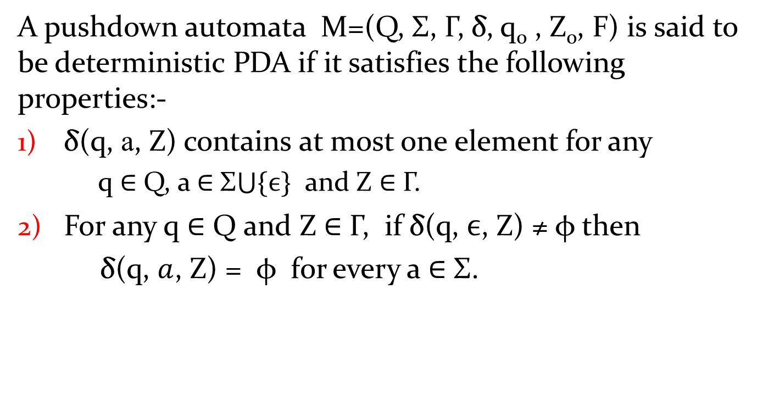
Deterministic Pushdown Automta(DPDA)
A pushdown automata M=(Q, Σ, Γ, δ, q₀ , Z₀, F) is said to be deterministic PDA if it satisfies the following properties:-
δ(q, a, Z) contains at most one element for any
q ∈ Q, a ∈ Σ$\bigcup{\{ϵ\}}$ and Z ∈ Γ.
For any q ∈ Q and Z ∈ Γ, if δ(q, $ϵ$, Z) ≠ φ then
δ(q, $a$, Z) = φ for every a ∈ Σ.

Slide 40
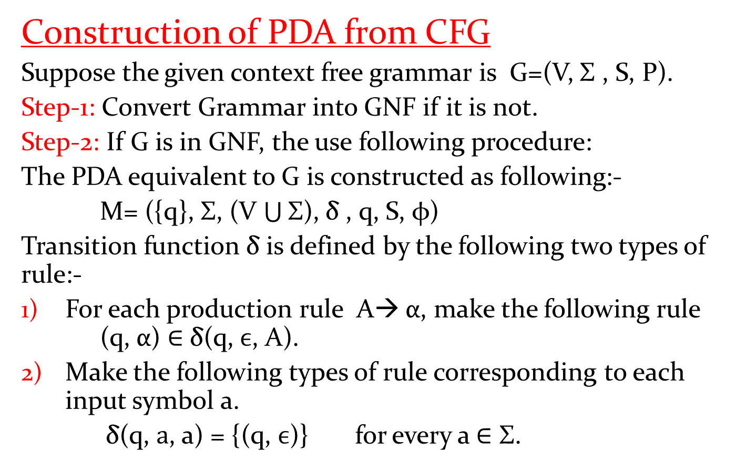
Equivalence of PDA and CFG
Construction of PDA from CFG
Suppose the given context free grammar is G=(V, Σ , S, P).
Step-1: Convert Grammar into GNF if it is not.
Step-2: If G is in GNF, the use following procedure:
The PDA equivalent to G is constructed as following:-
M= ({q}, Σ, (V $\bigcup{\text{Σ}}$), δ , q, S, φ)
Transition function δ is defined by the following two types of rule:-
For each production rule A→ α, make the following rule (q, α) ∈ δ(q, $ϵ$, A).
Make the following types of rule corresponding to each input symbol a.
δ(q, $a$, a) = {(q, $ϵ$)} for every a ∈ $\text{Σ}$.

Slide 41
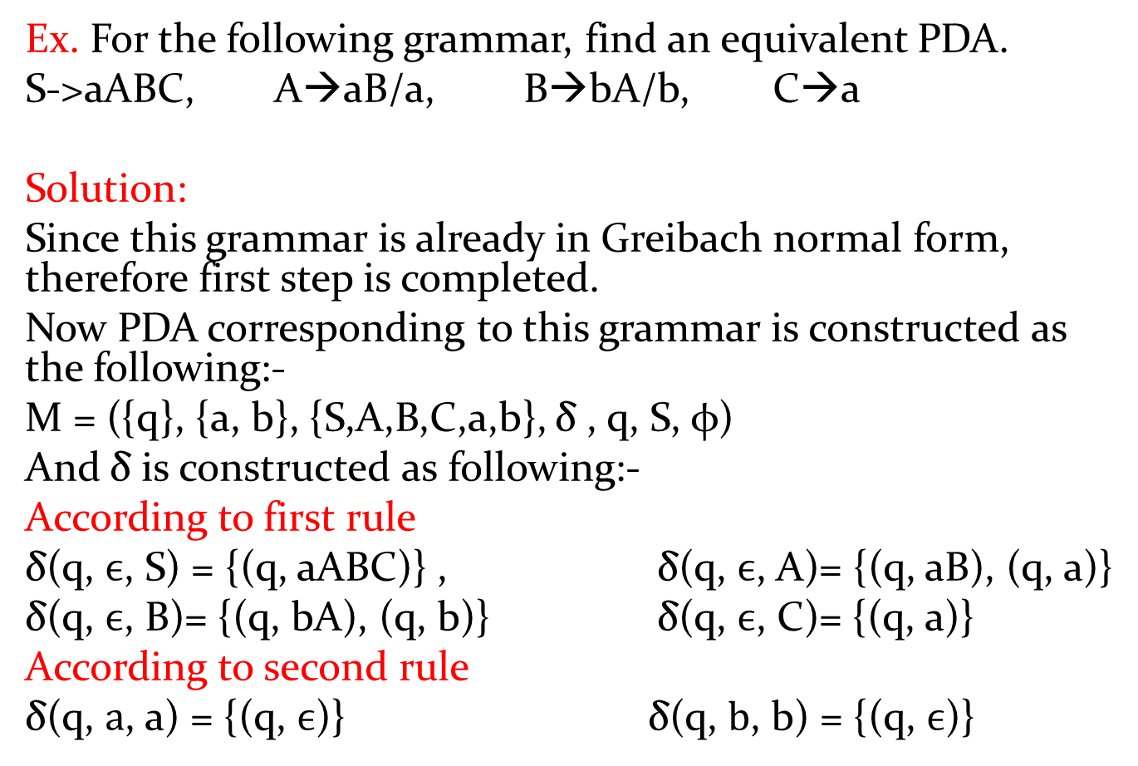
PDA from CFG
Ex. For the following grammar, find an equivalent PDA.
S->aABC, A→aB/a, B→bA/b, C→a
Solution:
Since this grammar is already in Greibach normal form, therefore first step is completed.
Now PDA corresponding to this grammar is constructed as the following:-
M = ({q}, {a, b}, {S,A,B,C,a,b}, δ , q, S, φ)
And δ is constructed as following:-
According to first rule
δ(q, $ϵ$, S) = {(q, aABC)} , δ(q, $ϵ$, A)= {(q, aB), (q, a)}
δ(q, $ϵ$, B)= {(q, bA), (q, b)} δ(q, $ϵ$, C)= {(q, a)}
According to second rule
δ(q, $a$, a) = {(q, $ϵ$)} δ(q, $b$, b) = {(q, $ϵ$)}

Slide 42
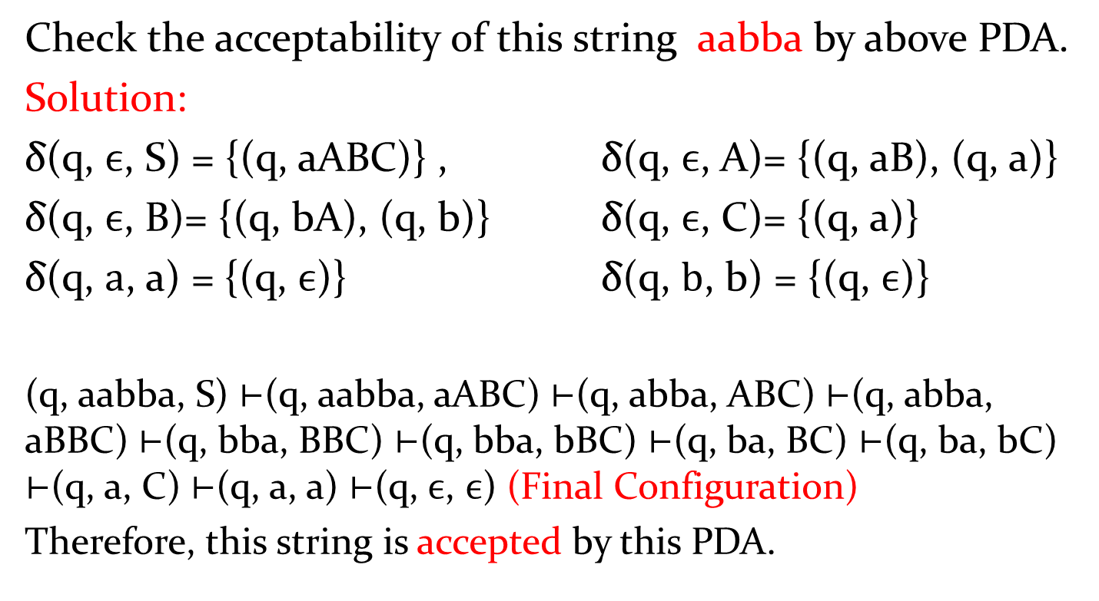
Check the acceptability of this string aabba by above PDA.
Solution:
δ(q, $ϵ$, S) = {(q, aABC)} , δ(q, $ϵ$, A)= {(q, aB), (q, a)}
δ(q, $ϵ$, B)= {(q, bA), (q, b)} δ(q, $ϵ$, C)= {(q, a)}
δ(q, $a$, a) = {(q, $ϵ$)} δ(q, $b$, b) = {(q, $ϵ$)}
(q, aabba, S) ⊢(q, aabba, aABC) ⊢(q, abba, ABC) ⊢(q, abba, aBBC) ⊢(q, bba, BBC) ⊢(q, bba, bBC) ⊢(q, ba, BC) ⊢(q, ba, bC) ⊢(q, a, C) ⊢(q, a, a) ⊢(q, $ϵ$, $ϵ$) (Final Configuration)
Therefore, this string is accepted by this PDA.

Slide 43
Ex. Construct PDA equivalent to the following CFG,
S→0BB, B→0S/1S/0
And check whether 010000 is in N(M) or not.

Slide 44
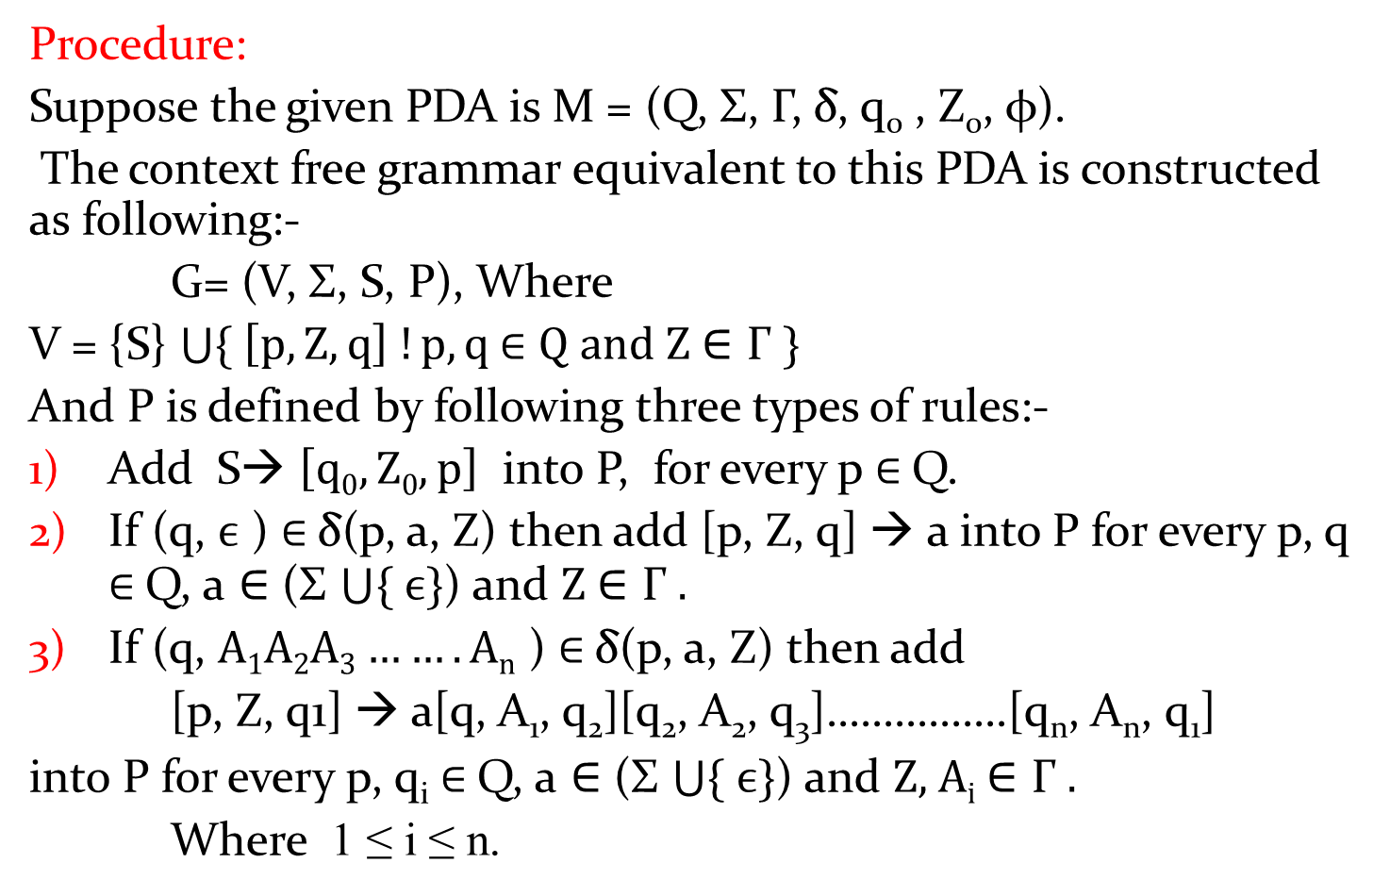
Construction of CFG from given PDA
Procedure:
Suppose the given PDA is M = (Q, Σ, Γ, δ, q₀ , Z₀, φ).
The context free grammar equivalent to this PDA is constructed as following:-
G= (V, Σ, S, P), Where
V = {S} $\bigcup{\{ \left[p, Z, q\right] !p,q \text{∈} Q and Z \text{∈} \text{Γ} \}}$
And P is defined by following three types of rules:-
Add S→ $\left[q0, Z0, p\right]$ into P, for every p $\text{∈}$Q.
If (q, $ϵ$ ) $\text{∈}$δ(p, a, Z) then add [p, Z, q] → a into P for every p, q $\text{∈}$Q, a $\text{∈}$ (Σ $\bigcup{\{ ϵ\}}$) and $Z \text{∈ }\text{Γ} .$
If (q, $A1A2A3…….An$ ) $\text{∈}$δ(p, a, Z) then add
[p, Z, q1] → a[q, A₁, q₂][q₂, A₂, q₃]…………….[q_{n}, A_{n}, q₁]
into P for every p, q_{i} $\text{∈}$Q, a $\text{∈}$ (Σ $\bigcup{\{ ϵ\}}$) and $Z\text{, }\text{Ai} \text{∈ }\text{Γ} .$
Where 1 ≤ i ≤ n.

Slide 45
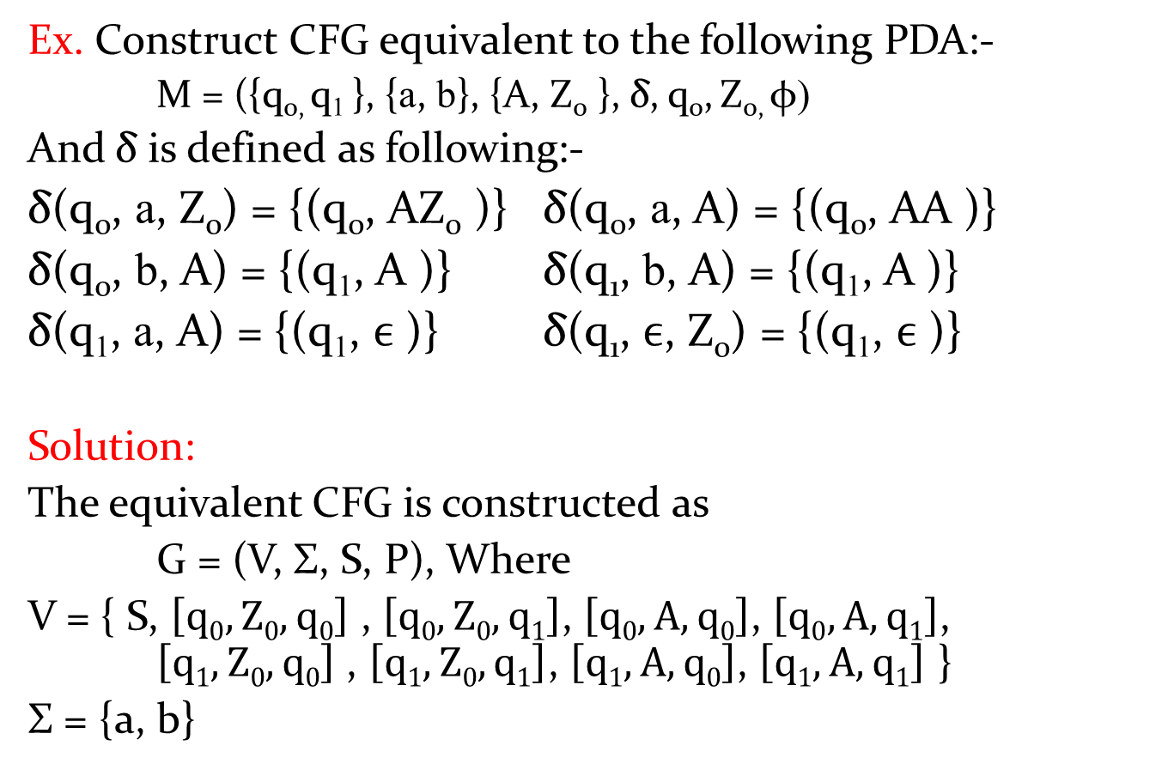
Ex. Construct CFG equivalent to the following PDA:-
M = ({q_{0,} q₁ }, {a, b}, {A, Z₀ }, δ, q₀, Z_{0,} φ)
And δ is defined as following:-
δ(q₀, a, Z₀) = {(q₀, AZ₀ )} δ(q₀, a, A) = {(q₀, AA )}
δ(q₀, b, A) = {(q₁, A )} δ(q₁, b, A) = {(q₁, A )}
δ(q₁, a, A) = {(q₁, $ϵ$ )} δ(q₁, $ϵ$, Z₀) = {(q₁, $ϵ$ )}
Solution:
The equivalent CFG is constructed as
G = (V, Σ, S, P), Where
V = { S, $\left[q0, Z0,q0\right]$ , $\left[q0, Z0,q1\right]$, $\left[q0, A,q0\right]$, $\left[q0, A,q1\right]$, $\left[q1, Z0,q0\right]$ , $\left[q1, Z0,q1\right]$, $\left[q1, A,q0\right]$, $\left[q1, A,q1\right]$ }
Σ = {a, b}

Slide 46
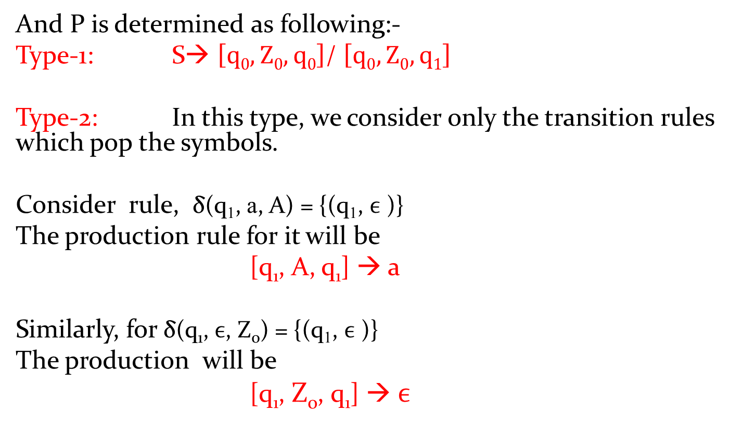
And P is determined as following:-
Type-1: S→ $\left[q0, Z0,q0\right]$/ $\left[q0, Z0,q1\right]$
Type-2: In this type, we consider only the transition rules which pop the symbols.
Consider rule, δ(q₁, a, A) = {(q₁, $ϵ$ )}
The production rule for it will be
[q₁, A, q₁] → a
Similarly, for δ(q₁, $ϵ$, Z₀) = {(q₁, $ϵ$ )}
The production will be
[q₁, Z₀, q₁] → $ϵ$

Slide 47
Type-3: In this type, we consider only the transition rules which push the symbols or no push and no pop operation.
Consider rule, δ(q₀, a, Z₀) = {(q₀, AZ₀ )}
The production rule for it will be
[q₀, Z₀, q₀] → a [q₀, A, q₀] [q₀, Z₀, q₀]
[q₀, Z₀, q₀] → a [q₀, A, q₁] [q₁, Z₀, q₀]
[q₀, Z₀, q₁] → a [q₀, A, q₀] [q₀, Z₀, q₁]
[q₀, Z₀, q₁] → a [q₀, A, q₁] [q₁, Z₀, q₁]
Consider rule, δ(q₀, b, A) = {(q₁, A )}
The production rule for it will be
[q₀, A, q₀] → b [q₁, A, q₀]
[q₀, A, q₁] → b [q₁, A, q₁]

Slide 48
Consider rule, δ(q₀, a, A) = {(q₀, AA )}
The production rule for it will be
[q₀, A, q₀] → a [q₀, A, q₀] [q₀, A, q₀]
[q₀, A, q₀] → a [q₀, A, q₁] [q₁, A, q₀]
[q₀, A, q₁] → a [q₀, A, q₀] [q₀, A, q₁]
[q₀, A, q₁] → a [q₀, A, q₁] [q₁, A, q₁]
Consider rule, δ(q₁, b, A) = {(q₁, A )}
The production rule for it will be
[q₁, A, q₀] → b [q₁, A, q₀]
[q₁, A, q₁] → b [q₁, A, q₁]

Slide 49
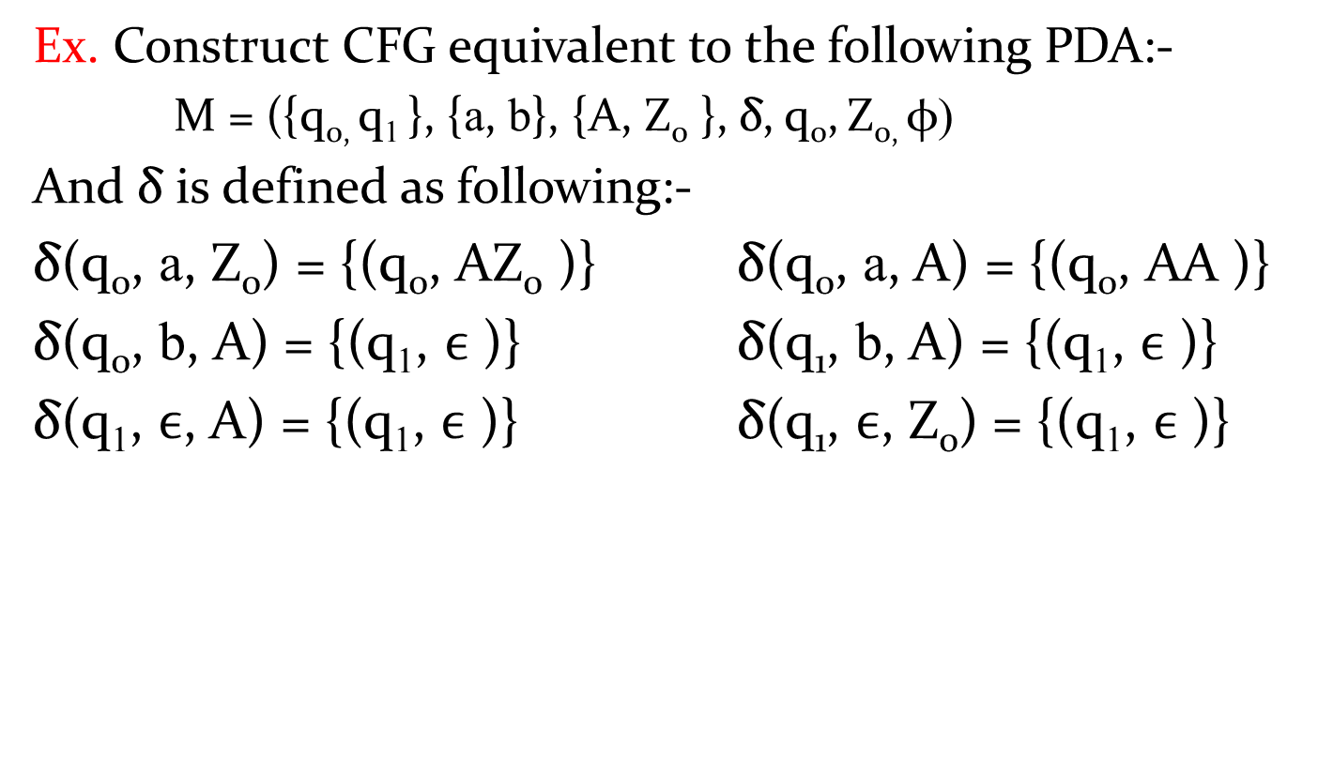
Ex. Construct CFG equivalent to the following PDA:-
M = ({q_{0,} q₁ }, {a, b}, {A, Z₀ }, δ, q₀, Z_{0,} φ)
And δ is defined as following:-
δ(q₀, a, Z₀) = {(q₀, AZ₀ )} δ(q₀, a, A) = {(q₀, AA )}
δ(q₀, b, A) = {(q₁, $ϵ$ )} δ(q₁, b, A) = {(q₁, $ϵ$ )}
δ(q₁, $ϵ$, A) = {(q₁, $ϵ$ )} δ(q₁, $ϵ$, Z₀) = {(q₁, $ϵ$ )}

Slide 50
Pushdown Automata
Part-6

Slide 51
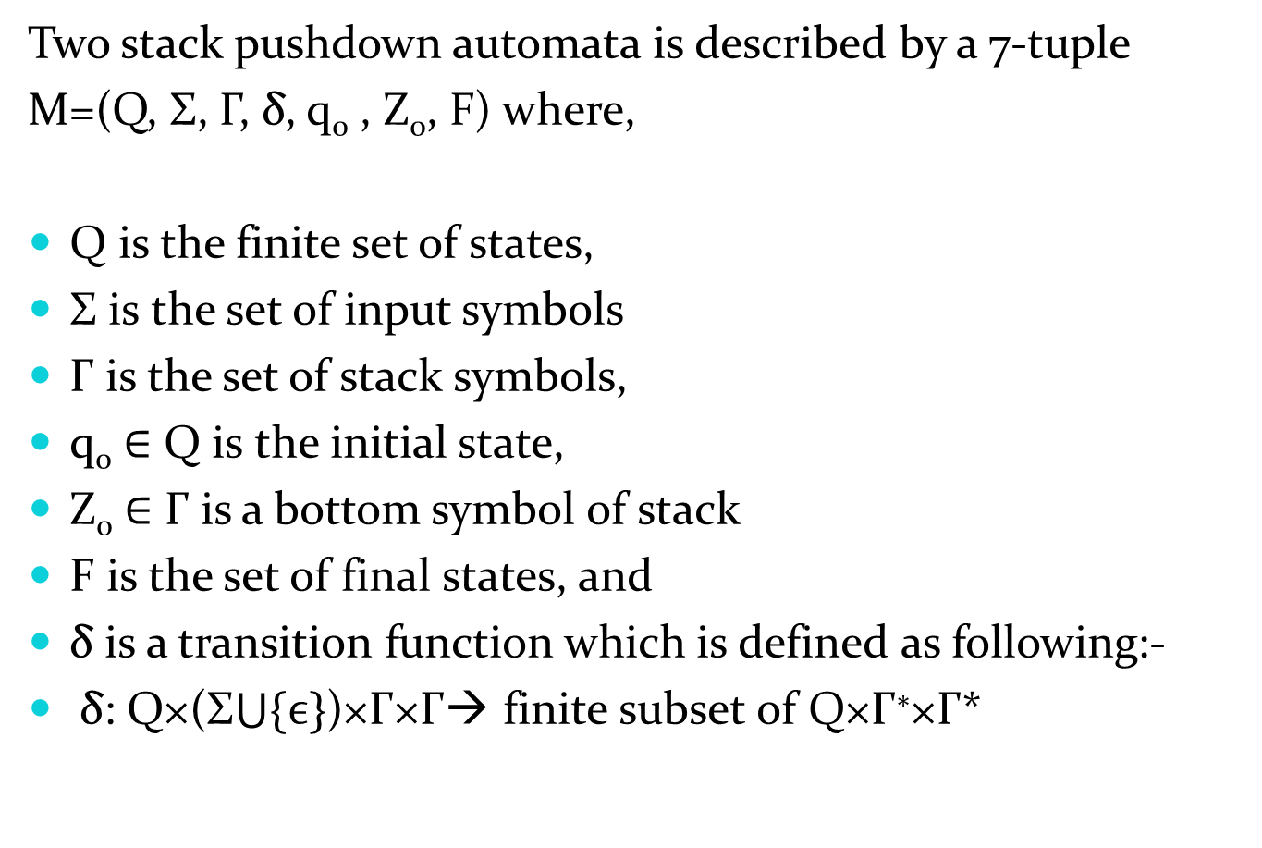
Two Stack PDA(2PDA)
Two stack pushdown automata is described by a 7-tuple
M=(Q, Σ, Γ, δ, q₀ , Z₀, F) where,
Q is the finite set of states,
Σ is the set of input symbols
Γ is the set of stack symbols,
q₀ ∈ Q is the initial state,
Z₀ ∈ Γ is a bottom symbol of stack
F is the set of final states, and
δ is a transition function which is defined as following:-
δ: Q×(Σ$\bigcup{\{ϵ\}}$)×Γ×Γ→ finite subset of Q×Γ∗×Γ*

Slide 52
Ex. Construct 2-stack PDA for the following language L = { a^{n}b^{n}c^{n} ! n ≥ 1}.
Solution:
In this set, some strings are abc, a²b²c², a³b³c³ etc.
Clearly, this set contains all the strings a, b and c, in which number of a, b and c are equal. And the order of a ,b and c are also fixed.
Procedure: In this PDA, we have to push the symbol A into first stack when a appears in input string.
When first b appears then we have to push symbol A into second stack and also change the state. For remaining b, we have to push symbol A into second stack at that state.
When first c appears then we check the top symbols of both stack. If both top symbols are A then we pop the top symbols from both stack. For remaining c, same operation is applied.
When string becomes empty, we check both stack. If top symbols of both stack are Z0, then string will be accepted.

Slide 53
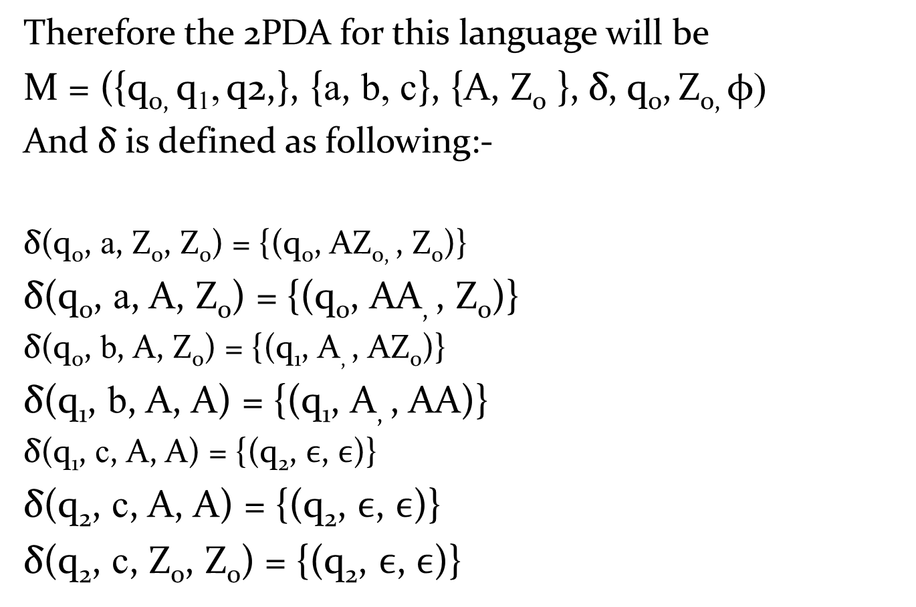
Therefore the 2PDA for this language will be
M = ({q_{0,} q₁, q2,}, {a, b, c}, {A, Z₀ }, δ, q₀, Z_{0,} φ)
And δ is defined as following:-
δ(q₀, a, Z₀, Z₀) = {(q₀, AZ_{0,} , Z₀)}
δ(q₀, a, A, Z₀) = {(q₀, AA, , Z₀)}
δ(q₀, b, A, Z₀) = {(q₁, A, , AZ₀)}
δ(q₁, b, A, A) = {(q₁, A, , AA)}
δ(q₁, c, A, A) = {(q₂, $ϵ$, $ϵ$)}
δ(q₂, c, A, A) = {(q₂, $ϵ$, $ϵ$)}
δ(q₂, c, Z₀, Z₀) = {(q₂, $ϵ$, $ϵ$)}

Slide 54
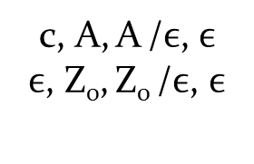
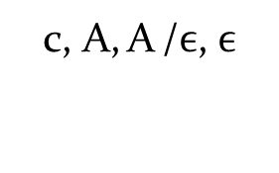
Transition diagram this 2PDA is
a, Z₀, Z₀ /AZ₀ , Z₀
a, A, Z₀ /AA , Z₀
c, A, A /$ϵ$, $ϵ$
$ϵ$, Z₀, Z₀ /$ϵ$, $ϵ$
, $ϵ$
b, A, A /A , AA
q₀
q₁
q₂
b, A, Z₀ /A , AZ₀
c, A, A /$ϵ$, $ϵ$ , $ϵ$

